Slide 1
PROJECT TITLE
CAPSTONE PROJECT
Presented By:Byri Geethik
Student Name : Byri Geethik
College Name & Department : DR. Lankapalli Bullaya College

Slide 2
OUTLINE
Problem Statement
Technology used
Wow factor
End users
Result
Conclusion
Git-hub Link
Future scope

Slide 3
Problem Statement
In today digital age, ebsuring data security and privacy is a top priority. Traditional encryption.
methods arwe often prone toi detection and interception. Our project tackles this challenge by using steganography to hide secret messages within images. This method offers covert communcation channel, enhancing data confidentiality without raising suspicion.

Slide 4
Technology used
Programming Languages: Python
Platform : Cross-platform(Windows)
Tools:Python3 (IDLE)
Libraries:
OpenCv for image processing
NumPy for efficient array manipulation

Slide 5
Wow factors
Implements robust LSB Steganography that embeds both the passcode and message length in the image header.
Uses lossless PNG format to preserve hidden data integrity.
Features a modern, user-friendly GUI for both encryption and decryption processes.
Combines advanced image processing techniques with secure data transmission.

Slide 6
End users
Law Enforcement and Intelligence Agencies
Military and Intelligence
Digital Right Managemnet
Whistleblowers

Slide 7
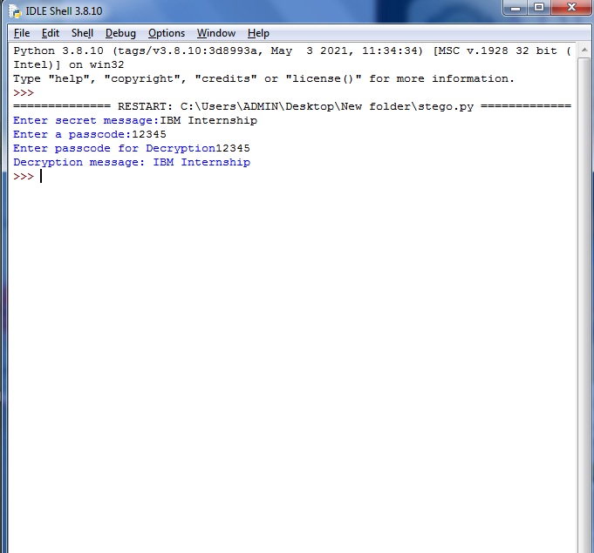
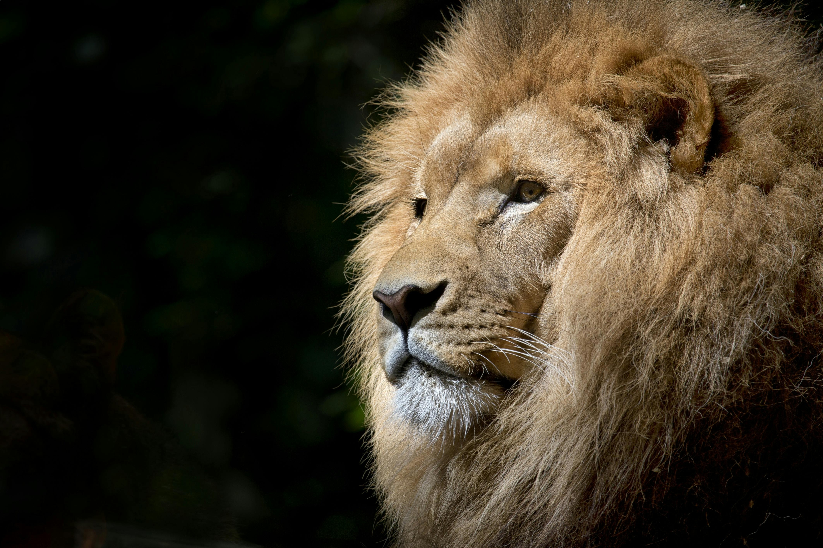
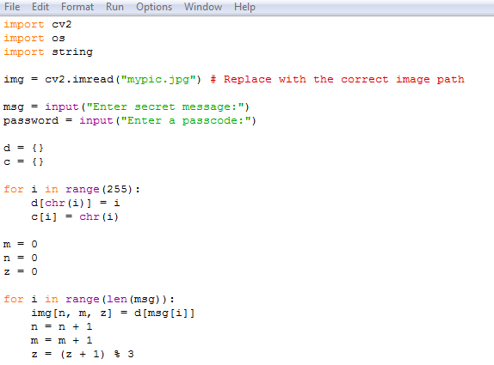
Results

Slide 8
Conclusion
Our project succesfully demonstrates a novel approach to data security by hiding information with in an image using LSB steganography.
This technique is both secure and undetectable, thanks to embedding critical header information such as passcode and message lengths.
The user-friendly GUI enhances the accessibility of the methos, making it a practical tool for secure communication.
This project contributes to the broader fiels of digital privacy and secure data transmission.

Slide 9
GitHub Link
Byri Geethik Steganography AICTE PPT .pptx
https://github.com/geethikbyri/stego.git

Slide 10
THANK YOU

